Slide 1

Module 3: Configuring Bridge Tables
0/5
Analytics: Advanced Server Architect
Notes:
Time: Lecture: <n – n> minutes; Labs: <n – n> minutes
Intent: <What is the instructional goal of the module>
Flow: < Describe at a high level the overall flow of the module>.
Key Terms: <List terms the instructor should be familiar with in order to teach this module>
<Term>
<Term>
<Term>
<Term>

Slide 2
Module Objectives
After completing this module you will be able to:
  Describe the purpose and process for configuring and using a bridge table
  Configure a bridge table in the repository
Why you need to know:
  Allows you to model complex many-to-many relationships between dimension tables and fact tables
Notes:
Each objective and “why you need to know” should be stated aloud.

Slide 3
Business Challenge and Solution
Dimensional star schemas are ideal for modeling part of a business when one-to-many relationships exist between the dimension tables and fact tables
Challenge: It is often necessary to model many-to-many relationships between dimension tables and fact tables
  It is not known in advance how many values the dimension might take on until the data is available
Solution: Use a bridge table to model these many-to-many relationships
Notes:
Engagement Question: Who would implement it?
Answer: Siebel Architect who configures the Analytics Metadata
Engagement Question: When are the requirements gathered to identify whether a bridge table design may be leveraged?
Answer: This information would be gathered during the Discover stage and designed during the Design stage of a project.
Engagement Question: Is this included in the Siebel Analytics Vanilla / Out of the Box product?
Answer: No.

Slide 4
Bridge Table
A logical table used to resolve the many-to-many relationships between dimension tables and fact tables
Resolves a many-to-many relationship into two one-to-many relationships between a dimension table and a fact table
Contains a weight factor column representing the ratio of the many-to-many relationships
  For example, if three sales representatives are associated with a given sales commission, the weight factor would be 1/3
    Multiplying the weight factor by the commission amount yields each sales representative’s share
    More complex weight factors may be used (for example, 1/2, 1/4, 1/4 instead of 1/3, 1/3, 1/3) as long as the total weight adds up to 1
Notes:
Engagement Question: Who would implement it?
Answer: Siebel Architect who configures the Analytics Metadata
Engagement Question: When are the requirements gathered to identify whether a bridge table design may be leveraged?
Answer: This information would be gathered during the Discover stage and designed during the Design stage of a project.
Engagement Question: Is this included in the Siebel Analytics Vanilla / Out of the Box product?
Answer: No.

Slide 5
Bridge Table: Example
In the sales industry, multiple sales representatives can be credited for the same commission
  Commission must be split among involved sales representatives
The weight factor column adds up all the splits to a value of “1” for a single commission
  Calculated as part of the ETL process while creating the data record
In this example, there is one record in the Sales Commissions table, two records in the Commissions/Sales Reps Bridge table, and two records in the Sales Reps table
Sales Commissions
Commissions/Sales Reps
Sales Reps
Commission Key Other Foreign Keys Commission Fact
Commission Key Sales Rep Key Weight Factor
Sales Rep Key Sales Rep Data
Fact table
Bridge table
Dimension table
Notes:
Engagement Question: Who would implement it?
Answer: Siebel Architect who configures the Analytics Metadata
Engagement Question: When are the requirements gathered to identify whether a bridge table design may be leveraged?
Answer: This information would be gathered during the Discover stage and designed during the Design stage of a project.
Engagement Question: Is this included in the Siebel Analytics Vanilla / Out of the Box product?
Answer: No.

Slide 6
Steps to Configure a Bridge Table
0/4
Identify Many-to-Many Relationship Tables
Configure the Repository
Save the Repository
Validate the Configuration
Notes:
This is a structuring slide. Do not teach the steps or concepts here because the following slides cover them in detail. Provide a high-level description of what will be discussed.

Slide 7
Identify Many-to-Many Relationship Tables
1/4
Review the requirements
Identify the dimension and fact tables
Identify the bridge table that will be used to resolve the many-to-many relationships between dimension and fact tables

Slide 8
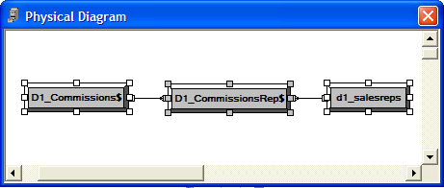
Configure the Repository
2/4
Open the repository using the Siebel Analytics Administration Tool
Create the keys and joins in the Physical layer
Define the physical joins in the Physical layer

Slide 9
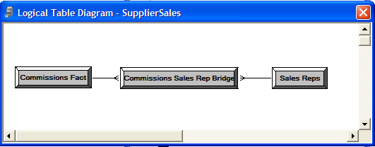
Configure the Repository Continued
2/4
Create the logical tables in the Business Model and Mapping layer
Define the logical joins and keys
Define the logical joins in the Business Model and Mapping layer

Slide 10
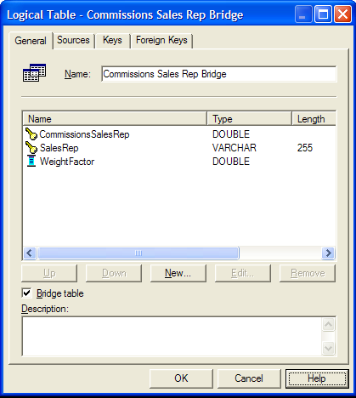
Configure the Repository Continued
2/4
Specify the bridge table option for the bridge table

Slide 11
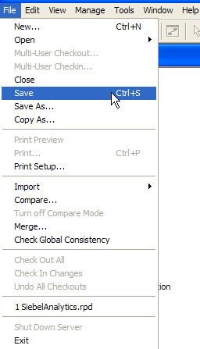
Save the Repository
3/4
Save the repository after configuring the bridge table

Slide 12
Validate the Results
4/4
Construct a query that includes the dimension and fact table
  For example, a query that includes Sales Rep and Commissions columns
Examine the query log to verify the results
  The commissions should be aggregated by sales rep
  The commissions should be multiplied by the weight factor when aggregated over the sales rep

Slide 13
Summary
This module showed you how to:
  Describe the purpose and process for configuring and using a bridge table
  Configure a bridge table in the repository
Notes:
Review Question: <Question>
Answer: <Answer>

Slide 14
Lab
In the lab you will:
  Configure a bridge table to resolve many-to-many relationships between dimension tables and fact tables
Notes:
Labs and Troubleshooting:
<Summarize the tasks the students will perform in this lab. Suggest specific guidance the instructor may provide if necessary to help the students complete the lab and avoid trouble spots.>

